Slide 1
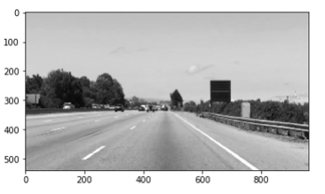
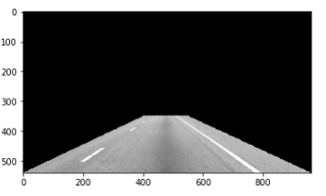
x | y | Z=x.y
0 | 0 | 0
0 | 1 | 0
1 | 0 | 0
1 | 1 | 1
REGION OF INTEREST MASKING: INTUITION
Our goal is to mask the region of interest so we can focus our search efforts for the lane lines.
MASK
BLACK (0)
WHITE (255)

